Slide 1
CSE 225: Digital Logic Design Introduction Salekul Islam United International University

Slide 2
Outline of this lecture
Base conversions
Decimal ↔ Binary
Any base → Decimal
Octal ↔ Binary
Hexadecimal ↔ Binary
Binary Codes
Binary Coded Decimal (BCD)
Binary arithmetic
Single Bit Addition with Carry
Multiple Bit Addition
BCD Addition

Slide 3
Binary Representation of Numbers
231.45 =
Here, 10 is called the radix or base of the number system
In 10-base systems, there are 10 symbols (‘0’, ‘1’, … , ‘9’)
In n-base system, there are n symbols (‘0’, ‘1’, … , ‘n-1’)
In binary (2-base) system, there are 2 symbols (‘0’, and ‘1’)

Slide 4

Class Room Practice
Consider the binary number 101.011
Calculate the decimal value of it.
The reverse process—converting a decimal to binary—is also straightforward.
Divide a decimal number is exact sum of positive and negative power of 2.
Successively divide by 2 and ½.

Slide 5
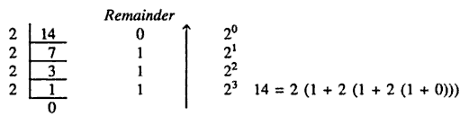
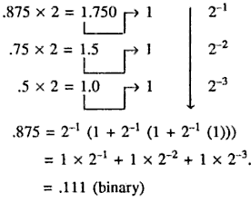
Decimal to Binary
Take decimal 14.875
Hence, 14 = 1110
For fractional part, we have to divide by ½ or multiply by 2.
14.875 = 1110.111 (binary)

Slide 6
Conversion Between Bases
To convert from one base to another:
1) Convert the Integer Part
2) Convert the Fraction Part
3) Join the two results with a radix point

Slide 7
Conversion Details
To Convert the Integral Part:
Repeatedly divide the number by the new radix and save the remainders. The digits for the new radix are the remainders in reverse order of their computation. If the new radix is > 10, then convert all remainders > 10 to digits A, B, …
To Convert the Fractional Part:
Repeatedly multiply the fraction by the new radix and save the integer digits that result. The digits for the new radix are the integer digits in order of their computation. If the new radix is > 10, then convert all integers > 10 to digits A, B, …

Slide 8
Example: Convert 46.6875₁₀ To Base 2
Convert 46 to Base 2
Convert 0.6875 to Base 2:
Join the results together with the radix point:
Notes:
Answer 1: Converting 46 as integral part: Answer 2: Converting 0.6875 as fractional part:
46/2 = 23 rem = 0 0.6875 * 2 = 1.3750 int = 1
23/2 = 11 rem = 1 0.3750 * 2 = 0.7500 int = 0
11/2 = 5 remainder = 1 0.7500 * 2 = 1.5000 int = 1
5/2 = 2 remainder = 1 0.5000 * 2 = 1.0000 int = 1
2/2 = 1 remainder = 0 0.0000
1/2 = 0 remainder = 1 Reading off in the forward direction: 0.1011₂
Reading off in the reverse direction: 101110₂
Answer 3: Combining Integral and Fractional Parts:
101110. 1011₂

Slide 9
Checking the Conversion
To convert back, sum the digits times their respective powers of r.
From the prior conversion of 46.6875₁₀
101110₂ = 32 + 8 + 4 + 2
= 46
0.1011₂ = 1/2 + 1/8 + 1/16
= 0.5000 + 0.1250 + 0.0625
= 0.6875

Slide 10
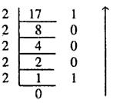

Class Room Practice
Convert decimal 17.375 to binary
17.375 = 10001.011 (binary)

Slide 11
Additional Issue - Fractional Part
Note that in this conversion, the fractional part became 0 as a result of the repeated multiplications.
In general, it may take many bits to get this to happen or it may never happen.
Example: Convert 0.65₁₀ to N₂
0.65 = 0.1010011001001 …
The fractional part begins repeating every 4 steps yielding repeating 1001 forever!
Solution: Specify number of bits to right of radix point and round or truncate to this number.

Slide 12
Any base → Decimal
Positive radix, positional number systems
A number with radix r is represented by a string of digits: A_{n - 1}A_{n - 2} … A₁A₀ . A₋ ₁ A₋ ₂ … A_{- m + 1} A_{- m}
in which 0 ≤ A_{i} < r and . is the radix point.
Find out the value of 65₇
Find out the value of 243.23₅

Slide 13
Positive Powers of 2
Useful for Base Conversion
Exponent
Value
Exponent
Value
0
1
11
2,048
1
2
12
4,096
2
4
13
8,192
3
8
14
16,384
4
16
15
32,768
5
32
16
65,536
6
64
17
131,072
7
128
18
262,144
8
256
19
524,288
9
512
20
1,048,576
10
1024
21
2,097,152

Slide 14
Commonly Occurring Bases
Name
Radix
Digits
Binary
2
0,1
Octal
8
0,1,2,3,4,5,6,7
Decimal
10
0,1,2,3,4,5,6,7,8,9
Hexadecimal
16
0,1,2,3,4,5,6,7,8,9,A,B,C,D,E,F
The six letters (in addition to the 10 integers) in hexadecimal represent:
Notes:
Answer: The six letters A, B, C, D, E, and F represent the digits for values
10, 11, 12, 13, 14, 15 (given in decimal), respectively, in hexadecimal.
Alternatively, a, b, c, d, e, f are used.

Slide 15
Numbers in Different Bases
Good idea to memorize!
Decimal
Binary
Octal
Hexa
decimal
(Base 10)
(Base 2)
(Base 8)
(Base 16)
00
00000
00
00
01
00001
01
01
02
00010
02
02
03
00011
03
03
04
00100
04
04
05
00101
05
05
06
00110
06
06
07
00111
07
07
08
01000
10
08
09
01001
11
09
10
01010
12
0A
11
0101
1
13
0B
12
01100
14
0C
13
01101
15
0D
14
01110
16
0E
15
01111
17
0F
16
10000
20
10

Slide 16
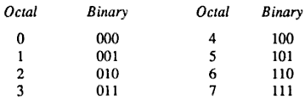
Octal ↔ Binary
8-base number system
8 symbols (0, 1, 2, 3, 4, 5, 6, 7)
Base/radix is power of 2
One-to-one relation between octal and binary
A binary number could be converted easily to octal
Group 3 bits and convert directly to octal

Slide 17
Octal ↔ Binary
Octal to Binary:
Restate the octal as three binary digits starting at the radix point and going both ways.
Binary to Octal:
Group the binary digits into three bit groups starting at the radix point and going both ways, padding with zeros as needed in the fractional part.
Convert each group of three bits to an octal digit.

Slide 18
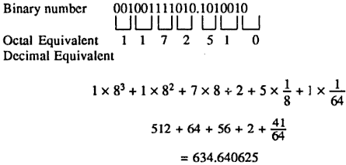
Binary to Octal to Decimal
Instead of converting binary to decimal
Faster process is binary to octal to decimal

Slide 19
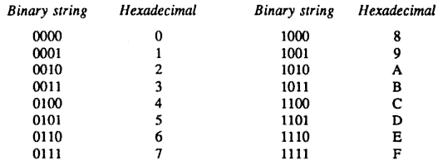
Hexadecimal ↔ Binary
16-base number system
16 symbols (0—9, A, B, C, D, E)
Again radix is power of 2
4 bits to represent a hexadecimal number

Slide 20

Hexadecimal ↔ Binary

Slide 21
Octal to Hexadecimal via Binary
Convert octal to binary.
Use groups of four bits and convert as above to hexadecimal digits.
Example: Octal to Binary to Hexadecimal
6 3 5 . 1 7 7 ₈
Notes:
Answer 1:
6 3 5 . 1 7 7 ₈
110|011|101 . 001|111|111 ₂
Regroup:
1|1001|1101 . 0011|1111|1(000)₂
Convert:
1 9 D . 3 F 8₁₆
Answer 2: Marking off in groups of three (four) bits corresponds to dividing or multiplying by 2³ = 8 (2⁴ = 16) in the binary system.

Slide 22
Binary Numbers and Binary Coding
Flexibility of representation
Within constraints below, can assign any binary combination (called a code word) to any data as long as data is uniquely encoded.
Information Types
Numeric
Must represent range of data needed
Very desirable to represent data such that simple, straightforward computation for common arithmetic operations permitted
Tight relation to binary numbers
Non-numeric
Greater flexibility since arithmetic operations not applied.
Not tied to binary numbers

Slide 23
Non-numeric Binary Codes
Given n binary digits (called bits), a binary code is a mapping from a set of represented elements to a subset of the 2^{n} binary numbers.
Example: A binary code for the seven colors of the rainbow
Code 100 is not used
Color
Binary Number
Red
000
Orange
001
Yellow
010
Green
011
Blue
101
Indigo
110
Violet
111

Slide 24
Number of Bits Required
Given M elements to be represented by a binary code, the minimum number of bits, n, needed, satisfies the following relationships:
2^{n} > M > 2^{(n – 1)}
n = log₂ M where x , called the ceiling function, is the integer greater than or equal to x.
Example: How many bits are required to represent decimal digits with a binary code?
Notes:
M = 10
Therefore n = 4 since:
2⁴ =16 is ≥ 10 > 2³ = 8
and the ceiling function for log₂ 10 is 4.

Slide 25
Number of Elements Represented
Given n digits in radix r, there are r^{n} distinct elements that can be represented.
But, you can represent m elements, m < r^{n}
Examples:
You can represent 4 elements in radix r = 2 with n = 2 digits: (00, 01, 10, 11).
You can represent 4 elements in radix r = 2 with n = 4 digits: (0001, 0010, 0100, 1000).

Slide 26
Binary Codes for Decimal Digits
There are over 8,000 ways that you can chose 10 elements from the 16 binary numbers of 4 bits. A few are useful:
Decimal
8,4,2,1
Excess3
8,4,
-
2,
-
1
Gray
0
0000
0011
0000
0000
1
0001
0100
0111
0100
2
0010
0101
0110
0101
3
0011
0110
0101
0111
4
0100
0111
0100
0110
5
0101
1000
1011
0010
6
0110
1001
1010
0011
7
0111
1010
1001
0001
8
1000
1011
1000
1001
9
1001
1
100
1111
1000

Slide 27
Binary Coded Decimal (BCD)
The BCD code is the 8,4,2,1 code.
This code is the simplest, most intuitive binary code for decimal digits and uses the same powers of 2 as a binary number, but only encodes the first ten values from 0 to 9.
Example: 1001 (9) = 1000 (8) + 0001 (1)
How many “invalid” code words are there?
What are the “invalid” code words?
Notes:
Answer 1: 6
Answer 2: 1010, 1011, 1100, 1101, 1110, 1111

Slide 28
Warning: Conversion or Coding?
Do NOT mix up conversion of a decimal number to a binary number with coding a decimal number with a BINARY CODE.
13₁₀ = 1101₂ (This is conversion)
13 ⇔ 0001|0011 (This is coding)

Slide 29
Binary Arithmetic
Single Bit Addition with Carry
Multiple Bit Addition
BCD Addition

Slide 30
Single Bit Binary Addition with Carry

Slide 31
Multiple Bit Binary Addition
Extending this to two multiple bit examples:
Carries 0 0
Augend 01100 10110
Addend +10001 +10111
Sum
Note: The 0 is the default Carry-In to the least significant bit.
Notes:
Carries 00000 01100
Augend 01100 10110
Addend +10001 +10111
Sum 11101 101101

Slide 32
BCD Arithmetic
Given a BCD code, we use binary arithmetic to add the digits:
8
1000
Eight
+5
+0101
Plus 5
13
1101
is 13 (> 9)
Note that the result is MORE THAN 9, so must be represented by two digits!
To correct the digit, subtract 10 by adding 6 modulo 16.
8
1000
Eight
+5
+0101
Plus 5
13
1101
is 13 (> 9)
+0110
so add 6
carry = 1
0011
leaving 3 + cy
0001 | 0011
Final answer (two digits)
If the digit sum is > 9, add one to the next significant digit

Slide 33
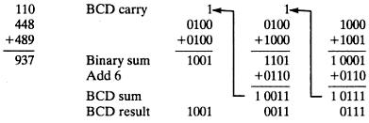
BCD Addition Example

Slide 34
BCD Addition Example
Add 2905_{BCD} to 1897_{BCD} showing carries and digit corrections.
0001 1000 1001 0111
+ 0010 1001 0000 0101
Notes:
1 1 1 0
0001 1000 1001 0111
+ 0010 1001 0000 0101
0100 10010 1010 1100
+ 0000+ 0110+ 0110+ 0110
0100 1000 0000 0010

